Slide 1
Qualities of Elders
1 Timothy 3:4, 5

Slide 2
Having children in submission
Children: TEKNA
Can mean “more than one”; IE - plural
This is known as “plural of class”, where the plural contains the singular. See Luke 20:28, 29; 1 Tim 5:4, 10; Titus 2:4; Genesis 21:7
Does a man have to have more than one child to become an elder?
What about adopted children? – Gal 4:5, 28

Slide 3
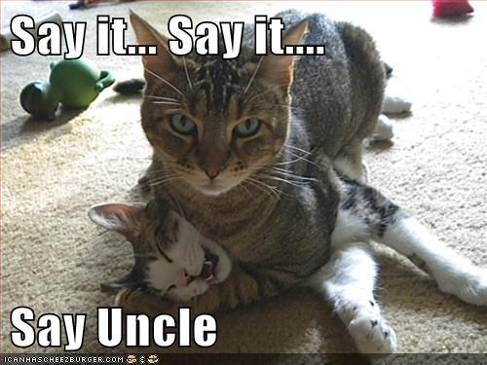
Having children in submission
Submission: HUPOTAGE
Obedience; subjection; to arrange; to subordinate
Just as Christians were to be in obedience to the Gospel – 2 Cor 9:13
Paul was not in submission to false teaching – Gal 2:5
Yet, an elder is to have his children in submission.
How does an elder accomplish this?
Does this justify forcing your kids into submission with any means?

Slide 4
Having children in submission
With all reverence: SEMNOTES
“With all gravity” – KJV
“With all dignity” – NASB
This seems to indicate how the children treat their father
Not only that the children are obeying
But expanding how the man works with his kids, and how they react to him overall. IE – not in rebellion (Titus 1:6)
Why is this quality important? See vs 5

Slide 5
For if a man does not know how to rule his own house, how will he take care of the church of God?
Paul reasons from the lesser (taking care of the family) to the greater (taking care of the church)
The man is to rule and manage the family
He is to show or prove that he will be worthy of an even greater task. Why greater?
Is the wife to be ruled over, like the children? – Gen 3:16
To determine if one could be qualified, just look at his family!

Slide 6
Not a novice – 3:6
Novice: NEOPHUTOS; “Newly Planted”
“novice” – KJV; ASV; NKJV
“recent convert” –ESV
“new convert”
Only time this word is used in the NT
Refers not to one young in years, but one “young in faith” – cf Lk 8:13
This shows that the church in Ephesus was not a young church, but had been established for a few years.

Slide 7
Not a novice – 3:6
What about an experienced Christian who moves to a new area and new church?
How long would he have to wait before he could become an elder?
At least long enough for people to get to know him, and him to get to know others.
How can he lead if the sheep don’t recognize his voice? -

Slide 8
Not a novice – 3:6
Why not a new convert?
Because egos could get out of control.
Temptation is to become “puffed up with pride”
Who else fell into this pride trap?
“Same condemnation as the devil”
God is going to give the same punishment to the prideful that he has reserved for Satan

Slide 9
Satan…
Is a created being – Neh 9:6; Ps 148:2; 103:21
But somehow rebelled against God – Jude 6
Is awaiting the Judgment – 2 Pet 2:4
Has limited power and will be punished – Rev 12:10, 12
Likes to snare people – 1 Tim 3:7

