Slide 1
Qualities of Elders
1 Tim 3:2

Slide 2
Temperate
Nephalion – Vigilant, sober
Found in 3:11 describing deacons
Found in Titus 2:2 describing older men
This word is always used in the NT in a metaphorical sense (Vine)
Literally: Means, “to be sober; temperate; abstinent in respect to wine” – Pershbacher
Metaphorically:
To be calm, dispassionate and circumspect – Vine
To be free from every form of mental and spiritual ‘drunkeness’ – Bauer p 538
Filled with spiritual and moral zeal. Someone who is well-balanced, calm, careful. Not old boring and stuffy, but one who has learned from the experiences of life.

Slide 3
Temperate
Philo (20 BC to 50AD) used this word to describe Noah and what his son did to him
“Such then is the condition of the sober man; but when Moses speaks of Noah's "younger son," he is not so much meaning to make a statement respecting his age, as to show the disposition with which those persons are endued who are inclined to innovation…
Noah’s son was “without wine” while Noah was drunk on wine; both made bad decisions – Genesis 9:20-24

Slide 4
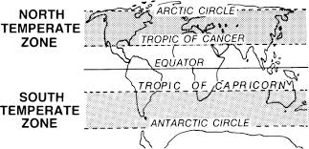
Temperate
Application:
What does it mean to be temperate?

Slide 5
Temperate
Application:
What would a temperate elder act like?
How would a temperate elder handle someone caught in sin? – cf Jn 8:3-9
Why would this quality be important?

Slide 6
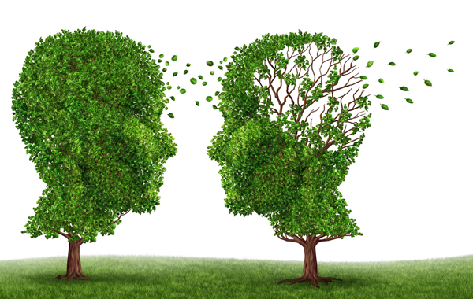
Sober-Minded
Sophrona – of sound mind; in one’s senses; sane
Notice that the word before, temperate, is a noun. This word is an adjective. What does that matter?
Refers to the inward mind; only time used in NT
This is a description of the soundness of the mind that the elder is to have. IE – no wild swings one way or the other.

Slide 7
Sober-Minded
Application:
How can age be a help to an elder?
How can it be a hindrance?
If one is not in their “right mind” would that disqualify them from serving as an elder?
If one struggles with or develops alzheimers, depression, anxiety, or schizophrenia, can they continue to serve as an elder?

