Slide 1
Qualities of Elders
1 Tim 3:2

Slide 2
Qualities vs Qualifications
What’s the difference?
Quality seems to be the essence of the person
“characteristic element” – Webster
Qualification seems to be the skill or ability
“skill; ability; that which fits one for the job”
Can I be kind, but not kind at heart?
Can I be hospitable, but not hospitable at heart?
Can I share, but not be sharing?

Slide 3
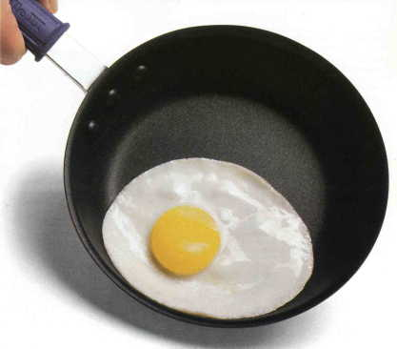
Qualities of Elders
#1 Blameless – anepilhptoV; 5:7; 6:14
Strong: not arrested; blameless; unrebukable
Thayer: Irreproachable
IE – no accusation “sticks” to this person because he is well known; Teflon Elders
See 1 Cor 1:8; Col 1:22
Application:
Could there be accusations? – 1 Tim 5:19
Possible sources? – 3:7
If they “stick” should he continue to serve?

Slide 4
Qualities of Elders
#2 Husband of one wife – miaV gunaikoV andra
Lit: “one woman man”
Same words as in Titus 1:6
MIAS: numeral one; single; one
GUNAIKOS: woman, wife, bride (Bauer 168)
ANDRA: man, in contrast to a woman or boy (Bauer 66)
Indicating sex; indicating age to distinguish an adult man from a boy (Thayer)

Slide 5
Qualities of Elders
#2 Husband of one wife – miaV gunaikoV andra
““The qualification requires that a man have one legal wife at a time, but not more than one.” “Qualification and Role of the Eldership”. Hearn, Roy J. Epistles of 1 and 2 Timothy and Titus.MSOP Lectures, 1986. Curtis Cates, Ed. Pg 71
Polygamy is rampant in Africa. Could the church just adapt this qualification to fit with their culture of having more than one wife?
Would one even have to be married? – see 3:3, 4

Slide 6
Qualities of Elders
Application:
What about a man whose first wife passed away, then remarried, could he serve as an elder?
See Romans 7:2 – released (render null; to make powerless)
Romans 7:3 – free (in a state of freedom)
Free to marry if her husband dies – 1 cor 7:39
Free, as in free from paying tax – Mt 17:26; Heb 2:14
Therefore, if a man’s spouse dies, he is FREE to marry another and that second marriage should not disqualify him from being a marriage. He was and is a “one woman man”

Slide 7
Qualities of Elders
Application:
What about a man whose first wife committed adultery, they divorced, and he later remarried biblically?
If you have the right to remarry, you have the right to serve as an elder.
Remember the “except for” in Mt 19:9, which shows that in one case, remarrying is Biblical.
If the “innocent” man remarries, why could the “innocent” man not serve as an elder?
Would it be right to punish someone who is “innocent”? If not, why not?

Slide 8
