Slide 1
Qualities of Elders
Titus 1:7

Slide 2
Above Reproach
Same word as in vs 6
Verse 6: blameless in regards to how he manages his family; home life
Verse 7: blameless in regards to being a good “steward of God”; church life and responsibilities
What is a steward?
Steward is a “house manager”; Lit: “house” “law”
What is God’s house? – 1 Tim 3:15
Who sets the rules?
Do we live by those rules?
Same word as in 1 Tim 3:2

Slide 3
Not self willed
5 “Nots” in verse 7 (negative attributes)
Stubborn, arrogant, self-pleasing
In disregard of others; set on having his way in everything (Lenski))
What would an elder act like if he was self-willed?
What would an elder act like if he was NOT self-willed?
How does pride factor in to a man becoming and serving as an elder? – cf 1 Tim 3:6

Slide 4
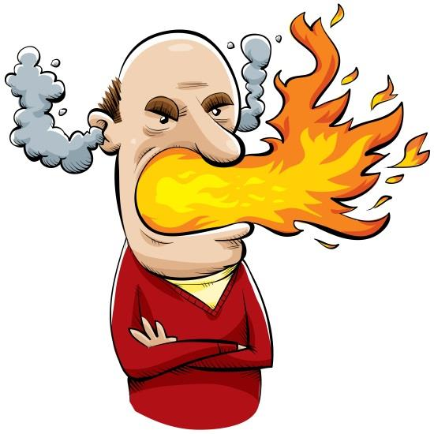
Not Quick Tempered – 1:8
Quick tempered – only time this word is found in NT
Does it have any relation to the previous word?
Not quick tempered: inclined to anger; inclined to toward the human emotion of indignation and wrath, and is easily provoked
Examples?
Why is this important? – Jm 1:20

Slide 5
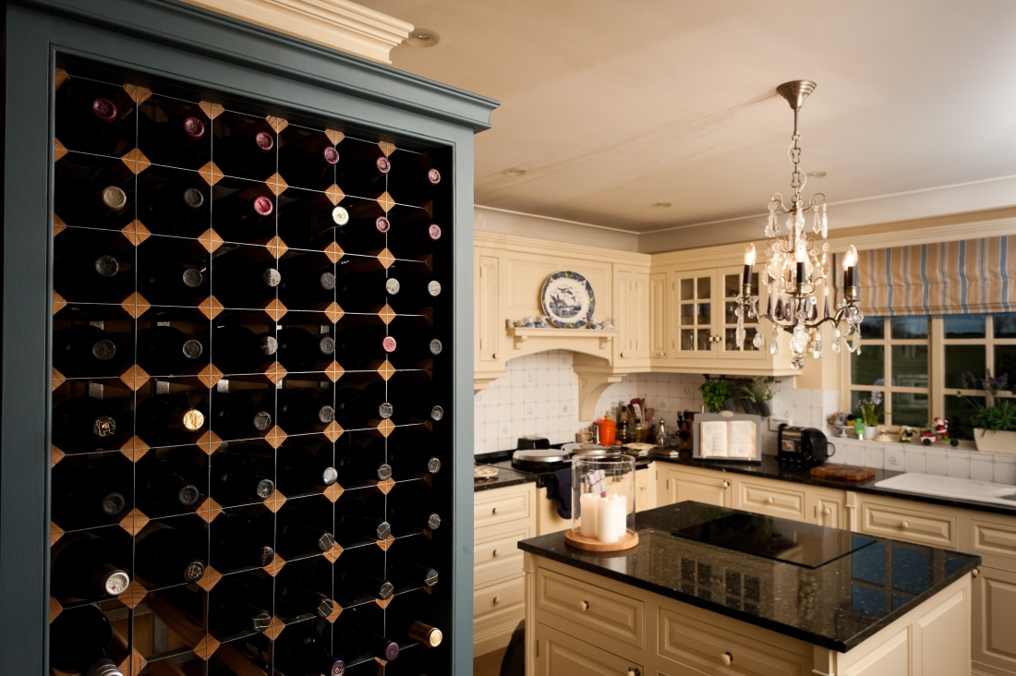
Not Given to Wine
Same word here and in 1 Tim 3:3 (PAROINON)
Literally: “Not beside the wine; not with wine”
An elder who abstains

Slide 6
Not Violent
Same word as in 1 Tim 3:3
Violent: a striker, a bully; quick to use fists in a dispute
An elder should be approachable, not put you in fear of bodily injury

Slide 7
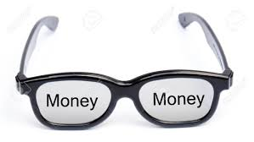
Not Greedy for Money
Same here as in 1 Tim 3:3
Might this be indicating that it is scriptural for elders to receive pay for their work? – cf 1 Tim 5:17, 18
How would a greedy elder hinder the Lord’s work?

Slide 8
Application:
God wants blameless stewards. Are you one?
All of us can ask:
Am I self-willed?
Am I quick tempered?
Do I have the right attitude towards wine / alcohol?
Am I greedy for money?

