Slide 1
Qualities of Elders
Titus 1:6

Slide 2
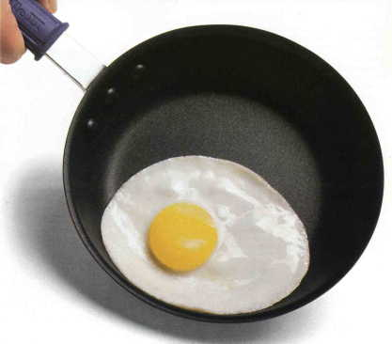
Blameless – 1:6
Same word as in vs 7 and 1 Timothy 3:2
Idea of a “teflon” elder

Slide 3
Husband of one wife -1:6
Lit: “one woman man”
Matthew Henry Commentary: “not having many wives at once, as at that time was too common both among Jews and Gentiles, especially among the Gentiles.”
Polygamy did exist in the first century. Justin Martyr. Dialogue with Trypho. 134.

Slide 4
Husband of one wife -1:6
Lit: “one woman man”
Can an elder continue to serve when his wife passes away?
Yes:
Because he is still a “one woman man”
Because he still meets all the other qualifications
No:
Because these are present tense qualifications
McGarvey – “If my wife should die, I would resign the as elder the next Sunday”

Slide 5
My Opinion:
Death does not change the qualifications:
If you have faithful children who pass away, would this disqualify you from becoming an elder?
However, it may fall into the “subjective” category.
Doesn’t an elder’s wife help bear the stress? If she has passed, who will help balance him out? – 1 Tim 3:11
I think it more wise to step down, because he will not be focused.

Slide 6
Having Faithful Children – 1:6
KJV – “having faithful children”
ASV – “having children that believe”
NASB – “having children who believe”
ESV – “his children are believers”
NIV – “a man whose children believe”
NLT – “children must be believers”

Slide 7
Having Faithful Children – 1:6
Literally: “Children having faith”
Children: TEKNA
Plural, but includes the singular – Ac 7:5
From the age of circumcision on up – Ac 21:21; Rom 9:7
Still a “child” no matter how old you are – ; Philemon 10; 1 Peter 1:14; 1Jn 3:1; 2 Jn 1, 4; 3 Jn 4
But, a child is not under your rule “no matter how old they are” – 1 Tim 3:4

Slide 8
Having Faithful Children – 1:6
Having: “to have as your own”
First, the man has children
By natural birth
Through adoption
Don’t’ have any children, then you don’t qualify
Second, the children have “faith”

Slide 9
Having Faithful Children – 1:6
Faith: PISTA
“faithfulness; reliability; trust; faith”
Faith in what?
Faith in God
Vine – “is used in the NT always of faith in God or Christ, or things spiritual”
Titus 1:1, 4, 13; 2:10; 3:15; 1 Tim 3:9
Idea is that the children are old enough to have obeyed “the faith” – Rom 1:5; 10:17; Gal 6:10; Eph 4:5; Col 1:4

Slide 10
Having Faithful Children – 1:6
Faith in what?
Faith in their father
Gus Nichols – “I think it means children faithful to their parents, and of course, if members of the church also faithful unto God” –pg 297
“children whose reputation will not be an embarrassment to their father and the church” – David Pharr. Sp Sw. Oct 2003. Pg 18
Next two qualifications apply to the children:
Not accused of dissipation
Not accused of insubordination
This shows they would have to believe in, and be faithful to their father.

Slide 11
What about if children fall away?
First, has church discipline been enacted?
Second, did they obey while he “ruled over them”? (1 Tim 3:4)
Third, what would a godly, humble elder do?
Does this effect “for if a man does not know how to rule his own house, how will he take care of the church of God” – 1 Tim 3:5

Slide 12
Application:
The way we raise our families is important? Are our priorities where they should be?
How is the example we are setting?
What can you do this week to improve your example?

